Slide 1
PRESENTATION ON PROJECT REPORT
PROJECT NAME :- ARMY DATABASE MANAGEMENT SYSTEM
SUPERVISED BY : TANJIM MAHMUD
SUBMITTED BY:
RAHAT AKHAND 2016-13-01
M.A. MONAEM KHAN 2016-13-14
MD.ABU SAMA 2016-13-43
MONJURUL AZAD 2014-11-0055

Slide 2
INTRODUCTION
There is around the 300k defense force in Bangladesh. So the database of this force would be huge. In this project, we just work with this huge amount of data and show the data to another soldier to minimize ways.

Slide 3
HARDWARE REQUIREMENT
Processor: intel core i3
Ram: 128 MB RAM
Hard Disk: 4 GB Hard disk
Java Interface On Desktop

Slide 4
SOFTWARE REQUIREMENT
Operating System: Microsoft Windows 7/8/10
Application Software: NetBeans, JDK (Java Development Kit), Xammp
Database: MySQL database Server

Slide 5
FEATURE’S
Soldiers can send an application for leave;
They can create their own password;
Soldiers are easily operating this database;
If the soldiers want to chat with admin they can;
They can get the notification for their approval;
They will also get Payment notification (upcoming);

Slide 6
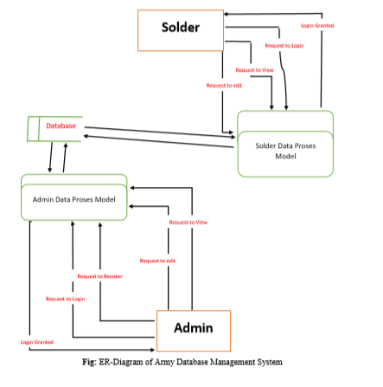
DATA FLOW DIAGRAM(DFD)

Slide 7
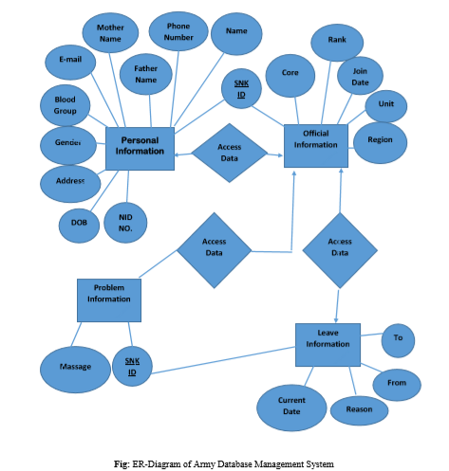
E-R DIAGRAM

Slide 8
SOME DEMO OF OUR PROJECT

Slide 9
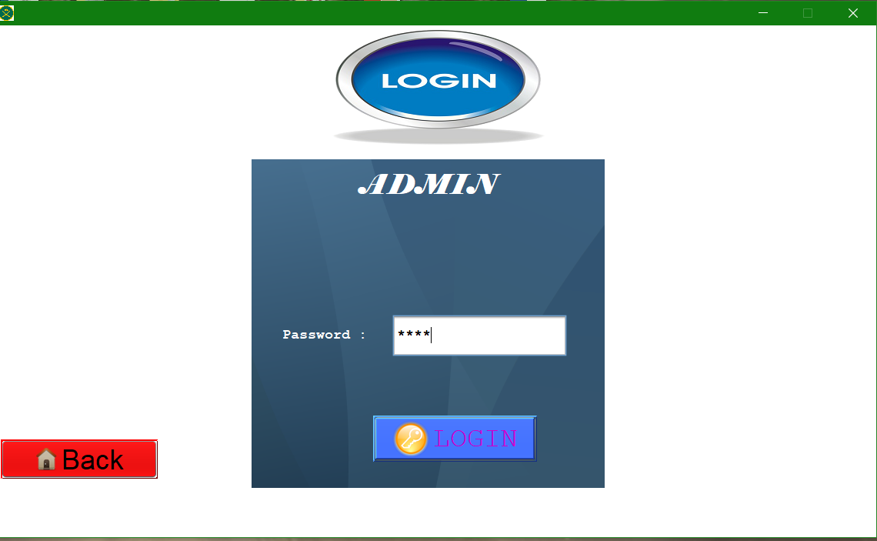
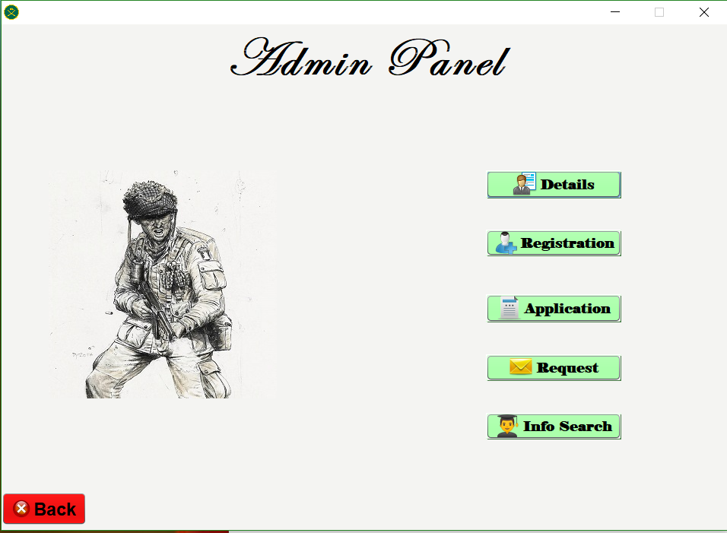

Slide 10
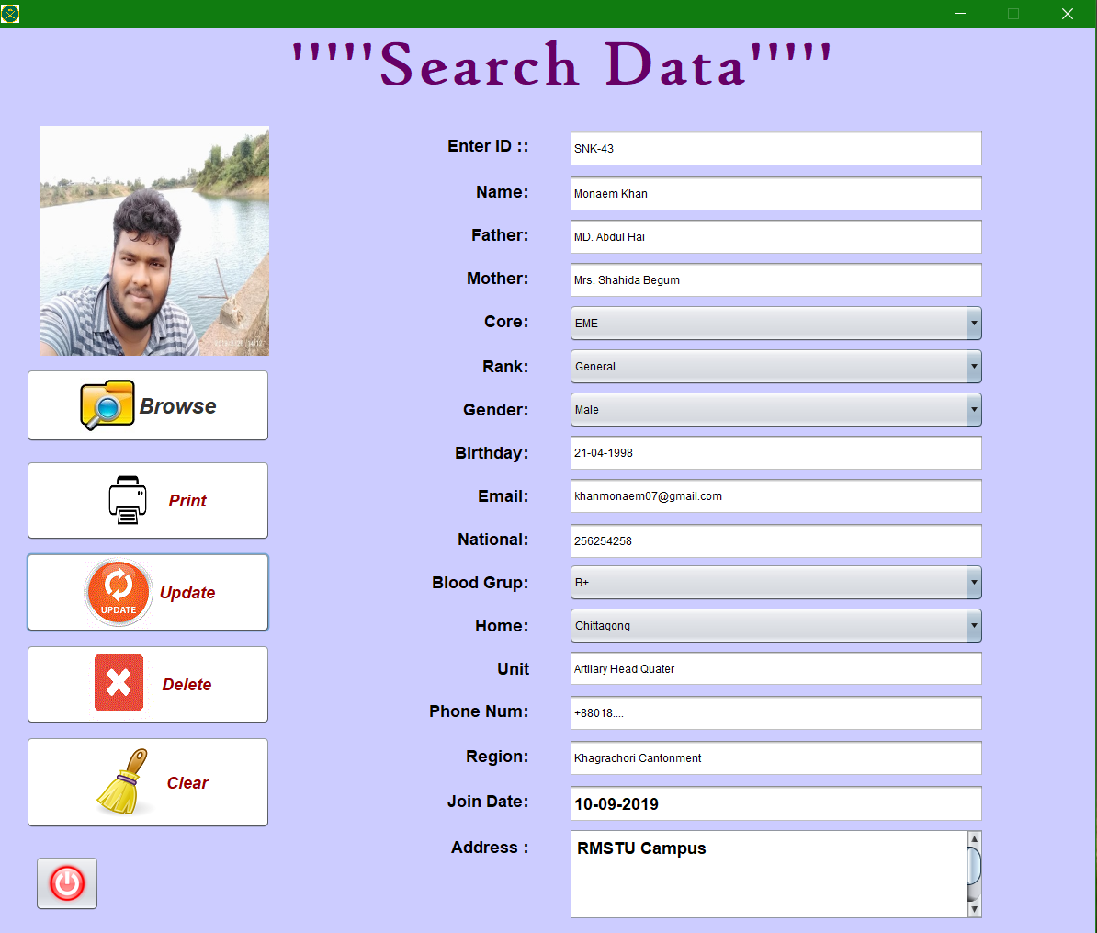
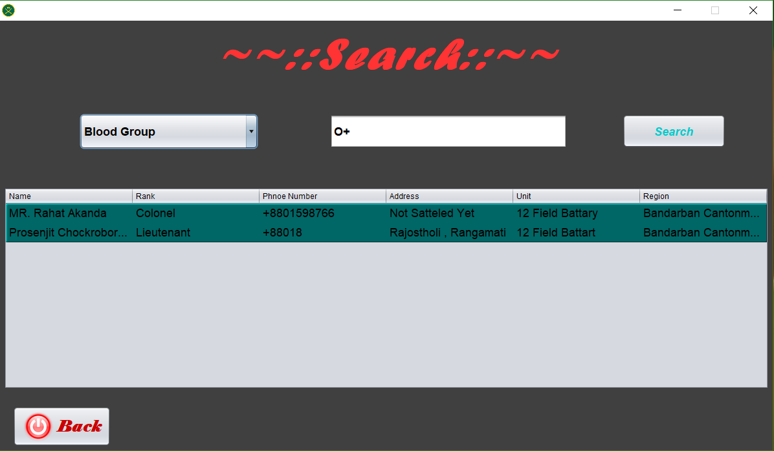

Slide 11
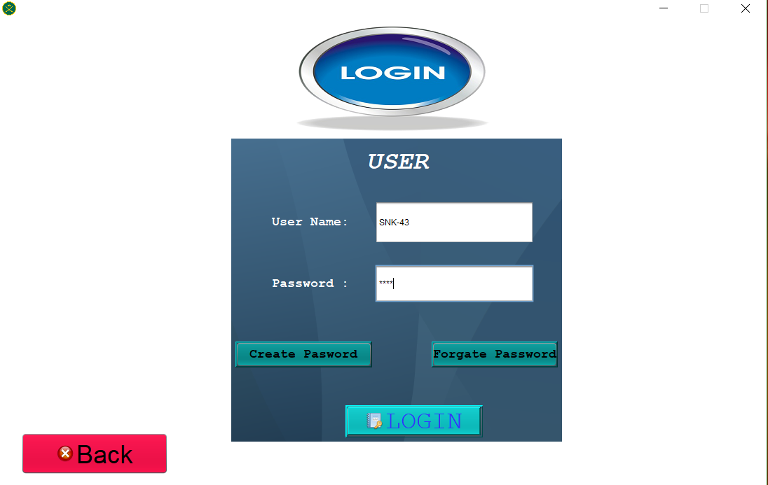
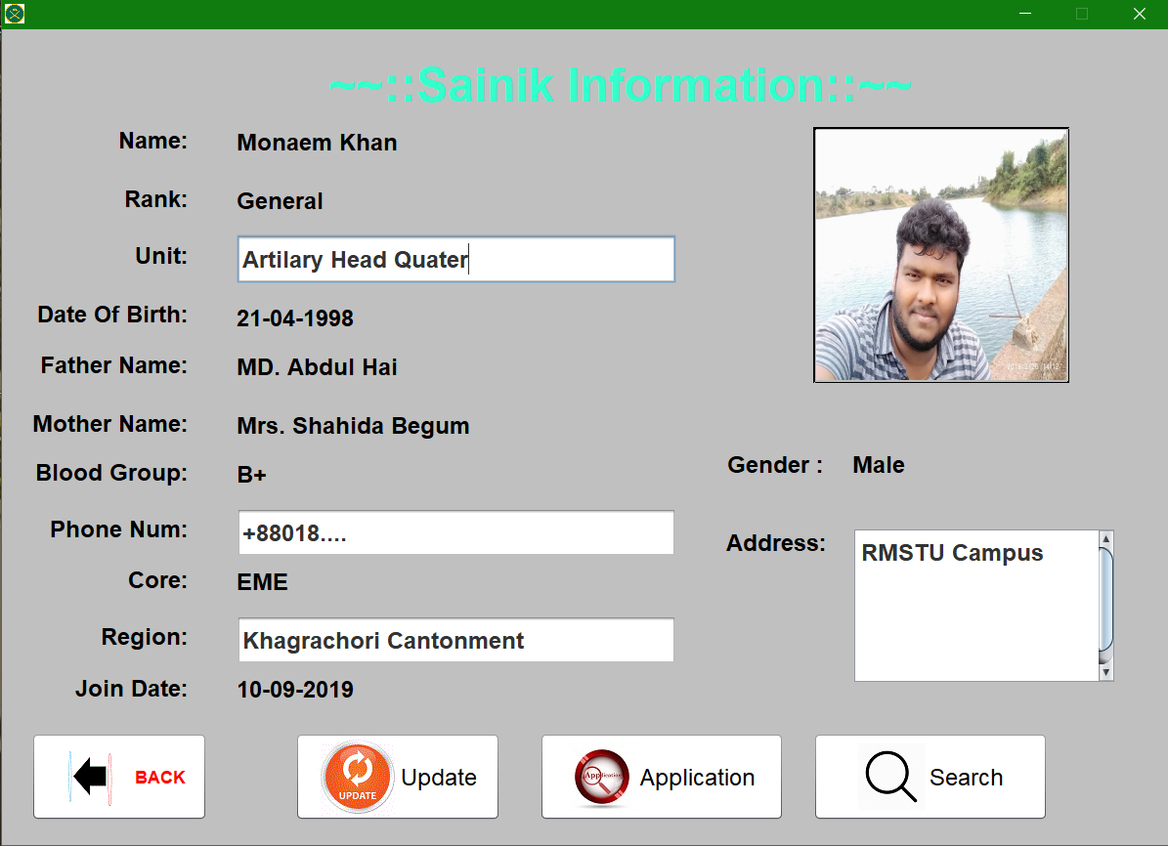

Slide 12
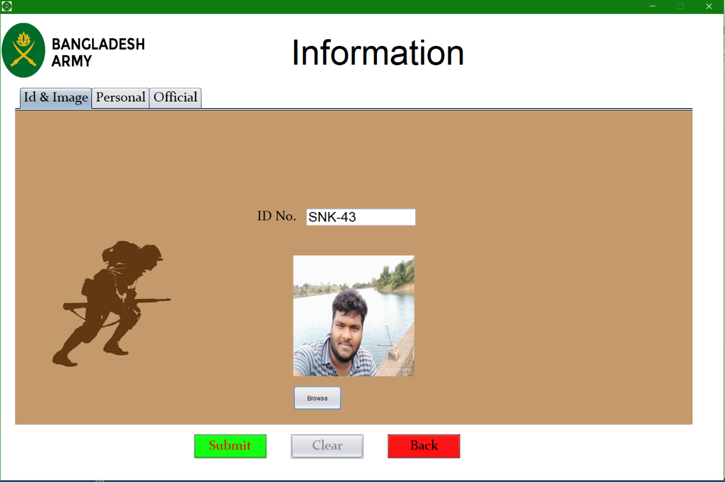
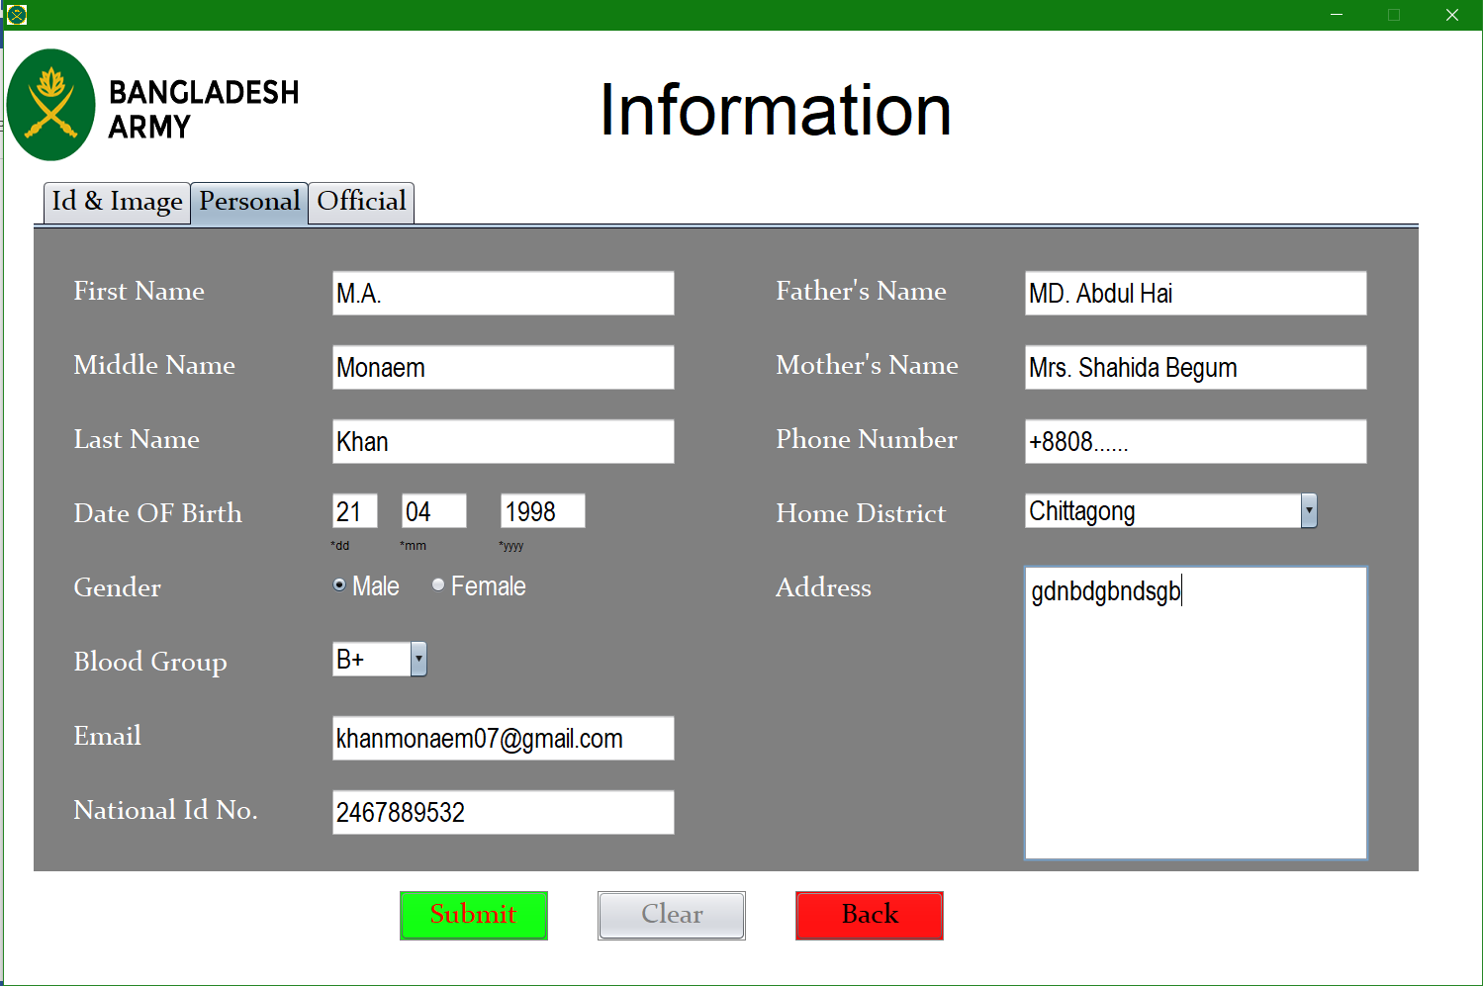
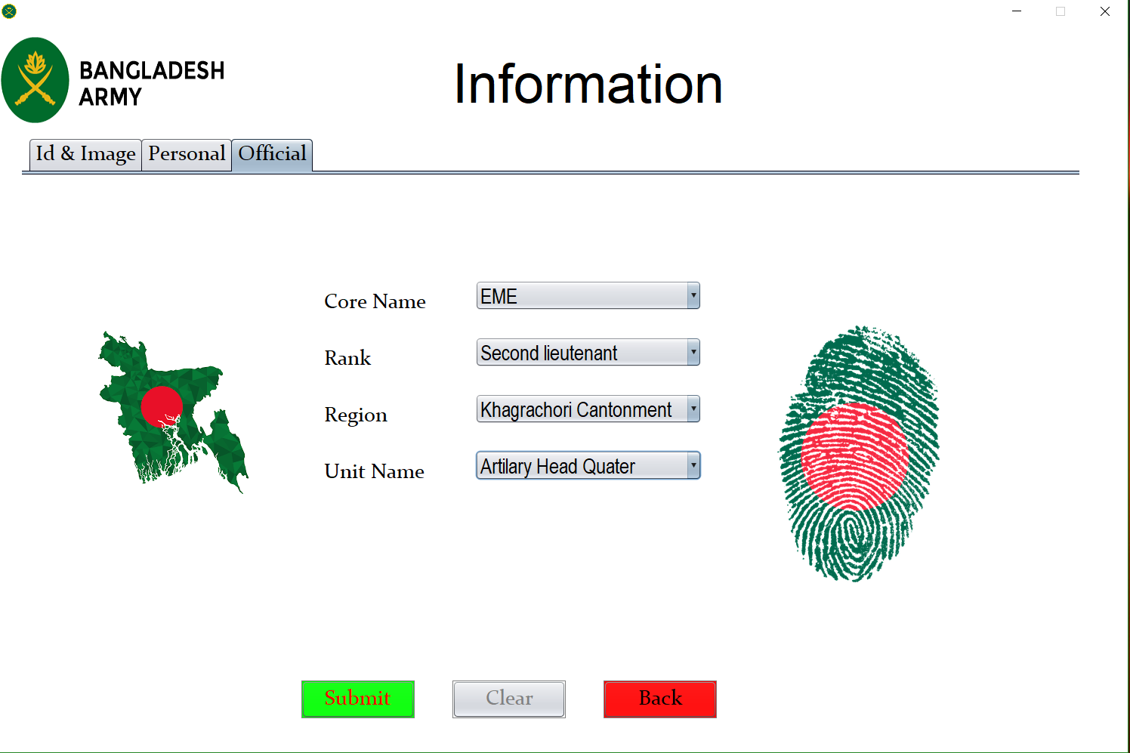

Slide 13
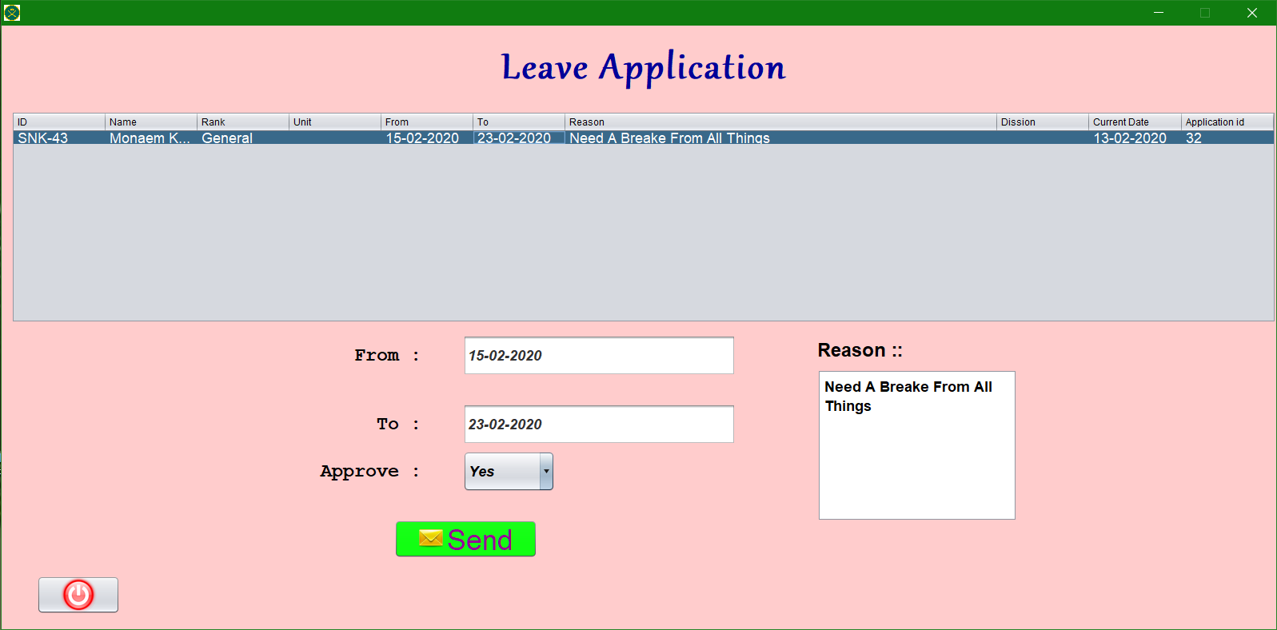
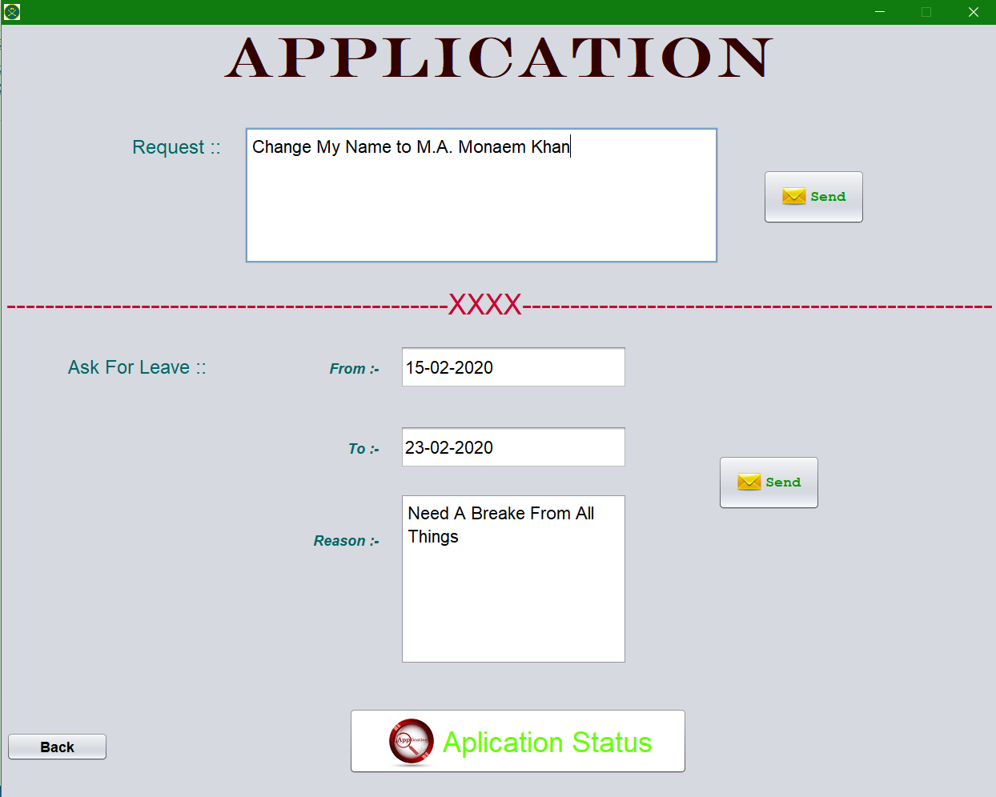
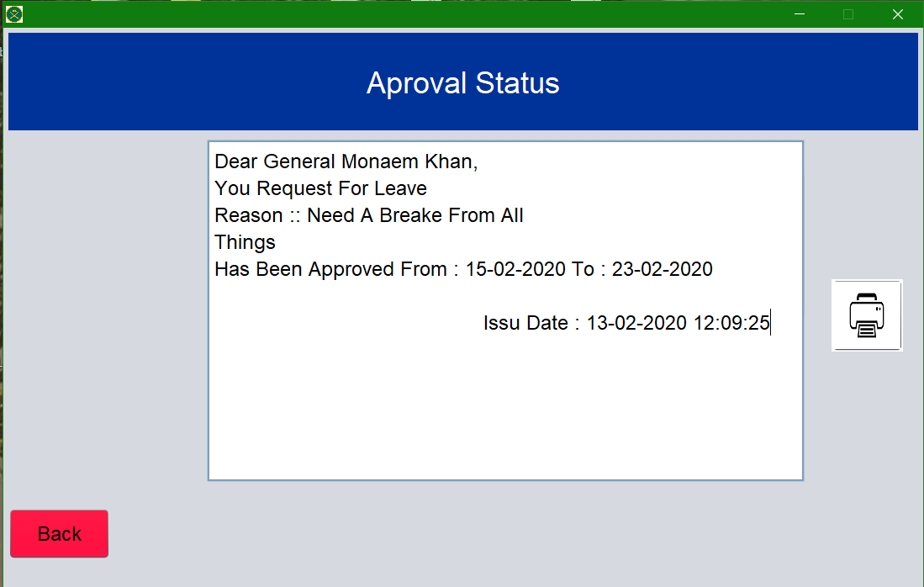

Slide 14
THANK YOU…!

